Slide 1

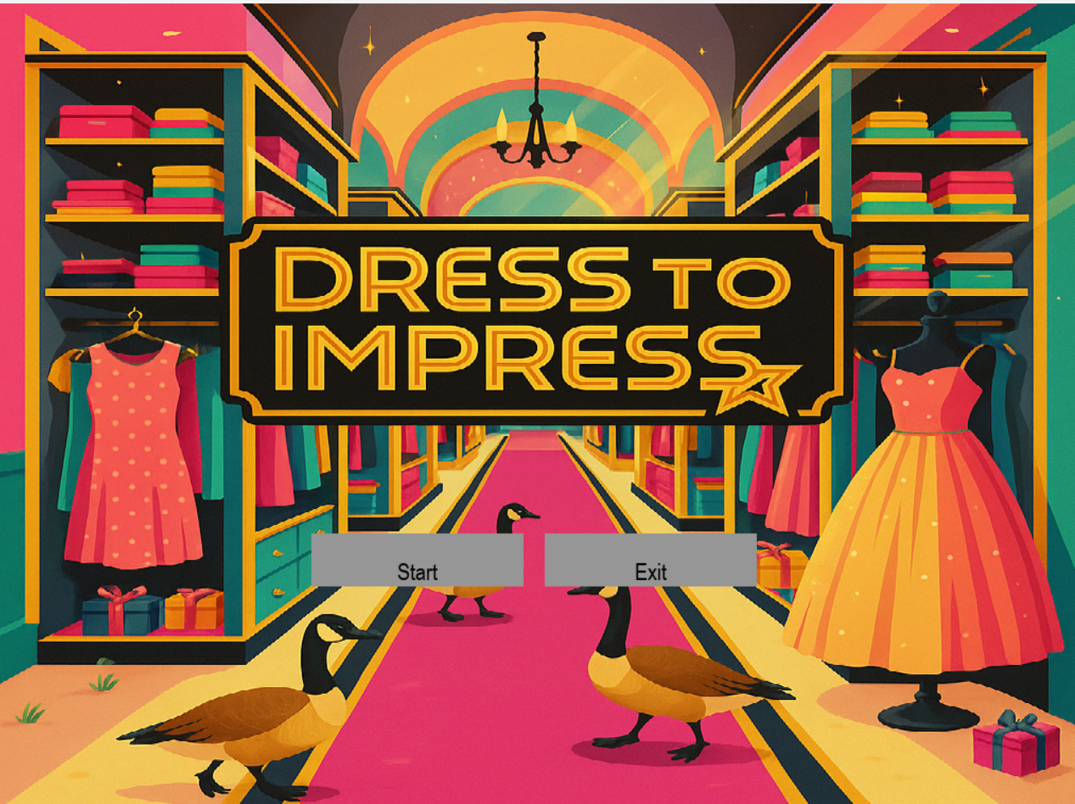
CHE120: Dress to Impress
___________
By: Arianna Di Tommaso, Linda Givens, and Anuva Nath

Slide 2

Breakdown of roles
Anuva | Arianna | Linda
Built a flowchart (which helped us configure the structure of the game) Responsible for building the functions at the start of the game, which were needed for game operation Responsible for building the main game loop Prepared graphics (start_up page background and professor avatars) Created the reusable Button class Added separate pages for start, gender and professor selection, mannequin, and ranking pages | Responsible for building the functions at the start of the game, which were needed for game operation Made docstrings (keeping the code organized) Prepared graphics (clothes and backgrounds) and dimensioned them accordingly Implemented unique features such as the prompt generator and play again function Debugged and troubleshooted the code | Responsible for building the functions at the start of the game, which were needed for game operation Made docstrings (keeping the code organized) Prepared graphics (pants) Uploaded the game audio Implemented unique features such as the timer and the automatic score Debugged the code
Notes:
As Anuva (AJ) was the most experienced with pygame, she began the game code by laying out the game’s structure and establishing the main game loop. She also researched the more difficult components, such as creating the button class and the slide-down closet, and implemented them into the code. Linda and Arianna then joined in the formation of the game. Together, they prepared the initial functions (such as the page and button functions) that permitted the game to run properly. Linda and Arianna took point on creating the graphic designs for the game—Linda creating the professor avatars (which was later changed by Anuva) and pants options for clothing as well as uploading the audio to the game, while Ariana created the rest of the clothes and backgrounds in her own style. The two then created the docstrings throughout the document, which helped to organize the code and help it make sense. Once that was complete, Linda and Arianna began the process of debugging the code. It was at this time that they added additional functions to the code (Linda created the timer and automatic score generator, while Arianna created the prompt generator and inputted the play again function), which truly brought the game together.

Slide 3
Game pitch
Inspired by Roblox’s iconic “Dress to Impress” game
Made completely from scratch!
Prompts the user to create an outfit based on prompts linked to the university (ie. “Choose an outfit to wear to a co-op interview”)
Incorporates aspects of the University of Waterloo (ie. professor avatar options, W-Store-inspired clothing choices, geese)
Includes a timer, which limits clothing selection to 40 seconds
Ranks the outfit created on a scale of 1 to 10 (using a random number generator)
The perfect game for CHE ‘30 students!
Notes:
Have you ever been in class bored of linear algebra and wondered what Jordan Hamilton would look like in a goofy goose hat and a pink tutu? Ever imagined what Pendar Mahoumdi would look like suited up in a lab coat with bunny slippers? Wonder no more! This game allows CHE '30 students to dress up their first-year professors in all sorts of interesting outfit combinations!
Our game draws thematically from the Roblox game Dress to Impress, following the same general game structure, except we made our "Professor-Dress-Up Game" from scratch! This allowed us to customize certain features to make the game funnier and more enjoyable for CHE ‘30 students at Waterloo. We have designed animated cartoon versions of each professor's faces to be pasted onto our mannequin; we have geese in the dressing room and much of the clothing take direct inspiration from the W-Store clothing or even actual items of clothing that our professors have worn before.
The game provides 3 male or female professor options for students to dress up. Once the game is started, players select gender and then select from 3 options. From the male options we have Jordan Hamilton, Michael Tam, and Boxin Zhao, and from the female options we have Pendar Mahoumdi, Comfort Mintah, and Dean Mary Wells. After selecting their professor, players are taken to the next page, where they can open a drop-down closet and select shoes, pants, shirts, and even hats! Once players are done dressing their professor, the game ranks the outfit they've put together between 1 and 10.

Slide 4
Challenges and Resolutions
Anuva was knowledgeable about coding, but Linda and Arianna were not
As new users of GitHub, they encountered many problems that slowed them down
As new coders, they had to do additional research on particular functions (ie. closet UI panel, timer, random number generator) to learn how to implement key game features
As we were nearing the end of the term, we were busy
Notes:
Closet UI Panel:
One of the key challenges that we encountered when writing this code was how to implement the closet panel that would display all the clothing items. Obviously, we wanted it to be some sort of button that, when clicked, would display all the subsequent clothing options but otherwise would keep them hidden. After learning how to create and move buttons, we knew it was an option to update each button's position manually and create loops that would update each button's position coordinates. But after doing some research, we learned a more efficient way was to move only the closet panel by updating menu_x, and because each button's position is drawn relative to menu_x, the buttons appear to slide with the closet. Therefore, the buttons in the closet don't actually physically move, but their draw position moves. The buttons are still functional because we updated their clickable area with the same offsets that we used when drawing them, so when the user clicks on the new button positions, the button actually works.
General:
Not just that, but it's crucial to remember that our group, in majority, is made up of inexperienced coders. As a result, some of the aspects of our assignment proved more difficult than they should have. GitHub, in particular, proved to be a confusing application to use. To combat this difficulty, they employed the help of their TAs and professor whenever they saw fit, which permitted their game design to truly flourish. Additionally, despite being given ample time to work on the video-game, the group found themselves anxious about completing their game amidst their busy end-of-term schedule. They found it difficult to prioritize working on the project at times, given that finals were looming. To combat this, they created a group chat as well as an organized chart designating tasks to each member at appropriate times.

Slide 5
reflection
Anuva | Arianna | Linda
There’s always room to grow (this can be done through in-class learning, independent learning, or just research) | Don’t be afraid or intimidated about learning new things--choose to be excited Sometimes you just need a good night’s sleep so you can face your problems with a fresh set of eyes tomorrow | Problems are often much simpler than they appear Take a deep breath and try not to get frustrated--the calmer you are, the clearer your thoughts will be

